Slide 1
COVID-19 Analysis using PostgreSQL
Mosharrat Marufa Sigma

Slide 2
Overview
The COVID-19 pandemic has undeniably left an indelible mark on global public health, necessitating the urgent derivation of data-driven insights to comprehend the virus’s proliferation.
In this project, I embarked on an analytical journey, leveraging SQL and data analysis proficiencies to excavate valuable insights from a comprehensive COVID-19 dataset. This dataset encapsulated a wealth of information, including geographic location, dates, confirmed cases, deaths, and recoveries.
Guided by a meticulously curated set of 16 insightful questions, my analysis aimed to distill meaningful conclusions from the raw data. The objective was to transform the data into knowledge, thereby shedding light on the patterns and trends inherent in the pandemic’s spread.
This endeavor was not merely an exercise in data analysis; it was a mission to contribute to the global understanding of a crisis that has affected us all. By transforming complex data into understandable insights, we can equip decision-makers with the information they need to combat the pandemic effectively.
In conclusion, this project underscored the power of data analysis in navigating through unprecedented times, reinforcing its indispensable role in today’s data-driven world. The insights derived from this analysis serve as a testament to the potential of data to guide us through the complexities of a global pandemic.

Slide 3
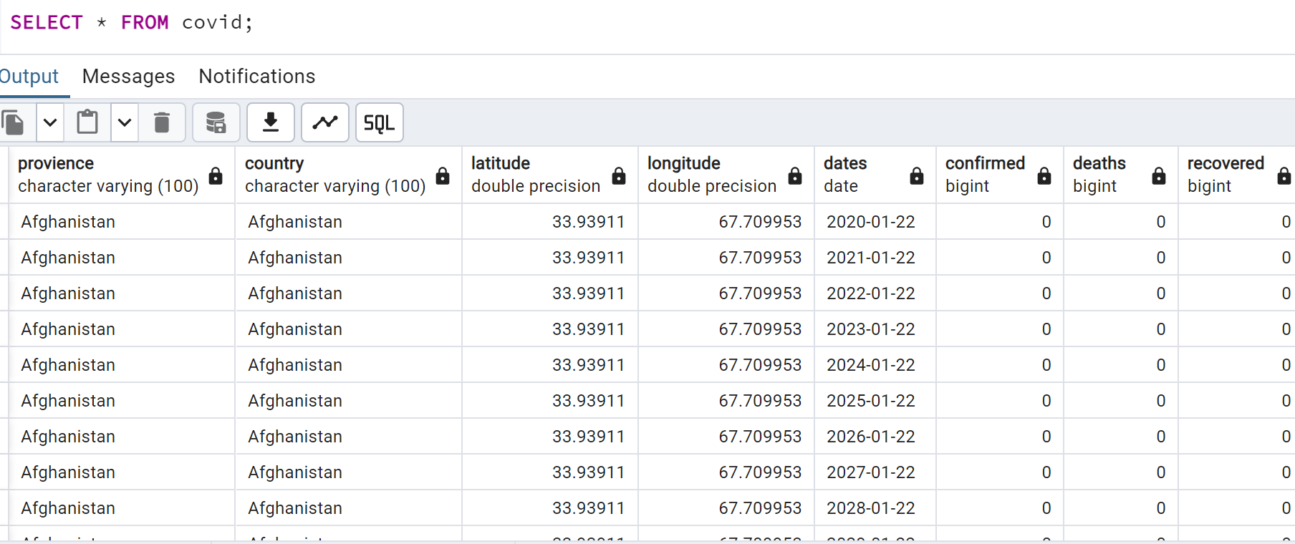
Dataset Overview

Slide 4
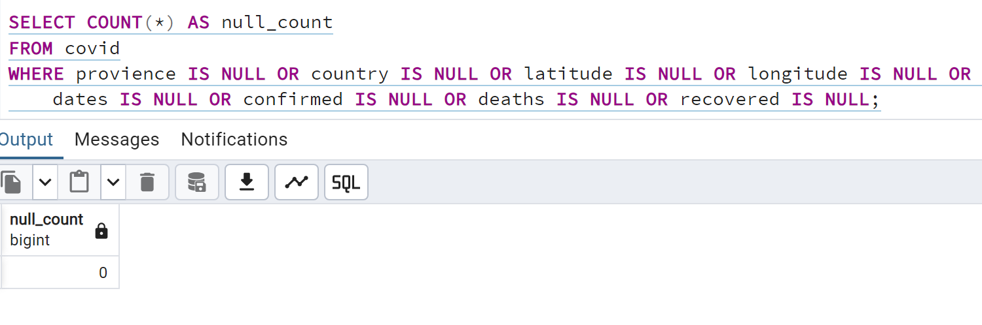
NULL Value Check
Q1. Write a code to check NULL values

Slide 5
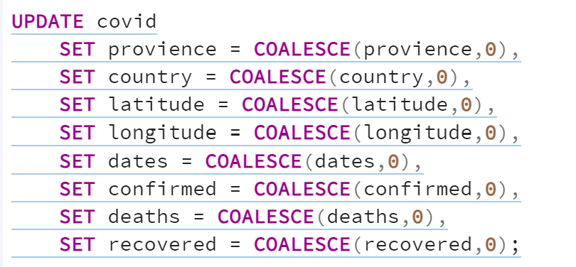
Replace NULL
Q2. If NULL values are present, update them with zeros for all columns.

Slide 6
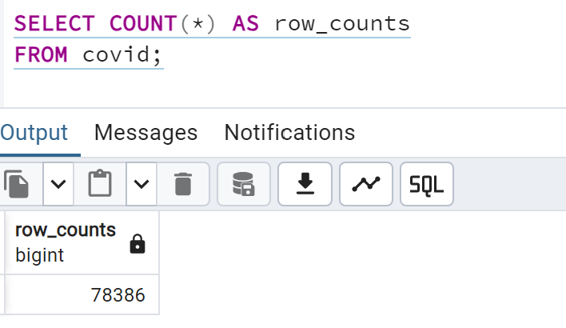
Row Count
Q3. check total number of rows

Slide 7
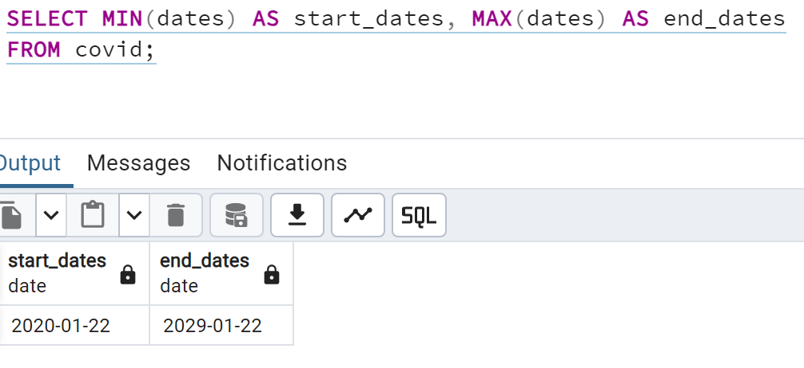
Start & End Date
Q4. Check what is start_date and end_date

Slide 8
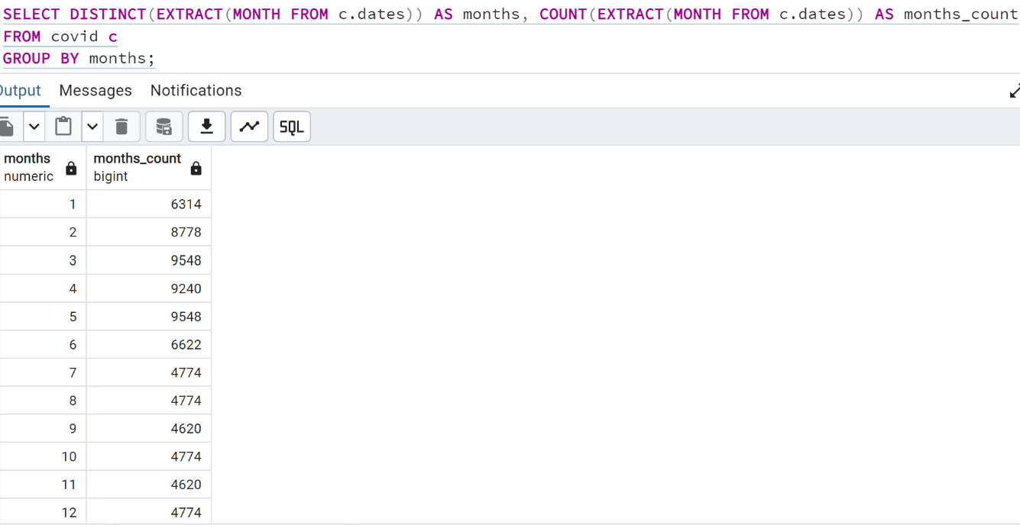
Monthly Count
Q5. Number of month present in dataset

Slide 9
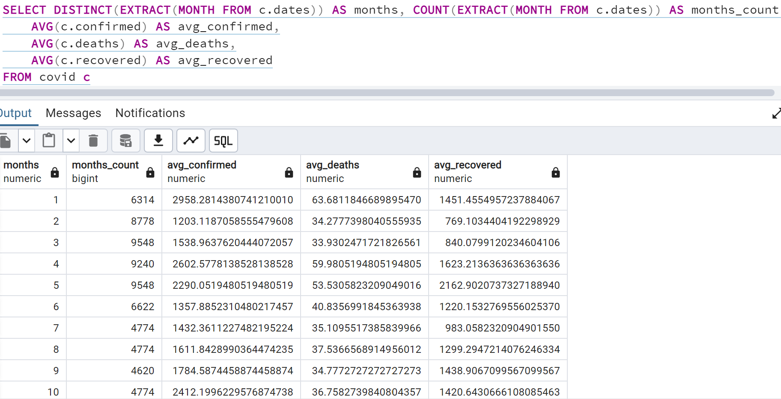
Average Monthly Count
Q6. Find monthly average for confirmed, deaths, recovered

Slide 10
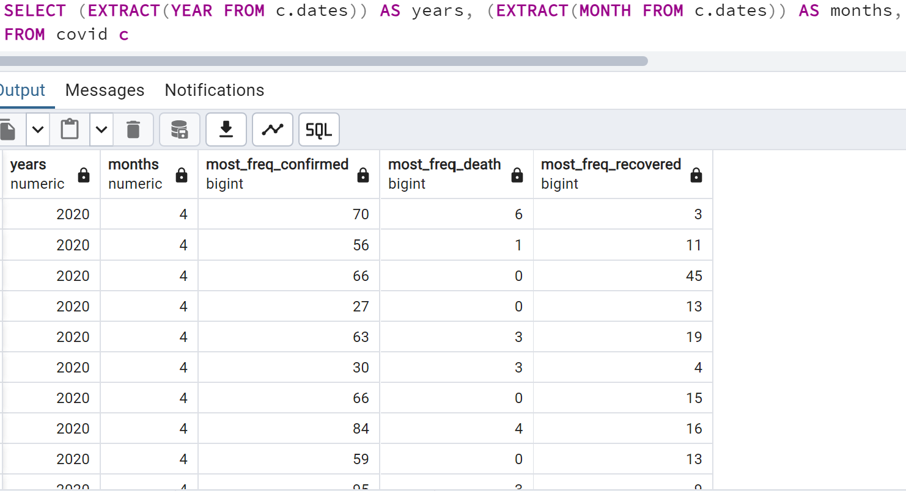
Frequency
Q7. Find most frequent value for confirmed, deaths, recovered each month

Slide 11
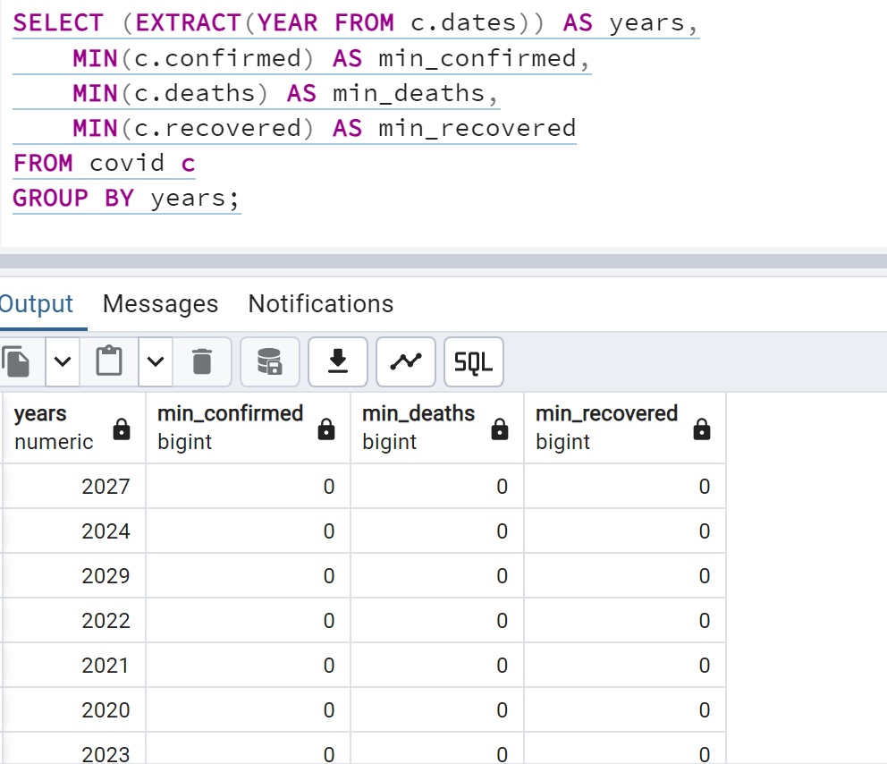
Minimum Count
Q8. Find minimum values for confirmed, deaths, recovered per year

Slide 12
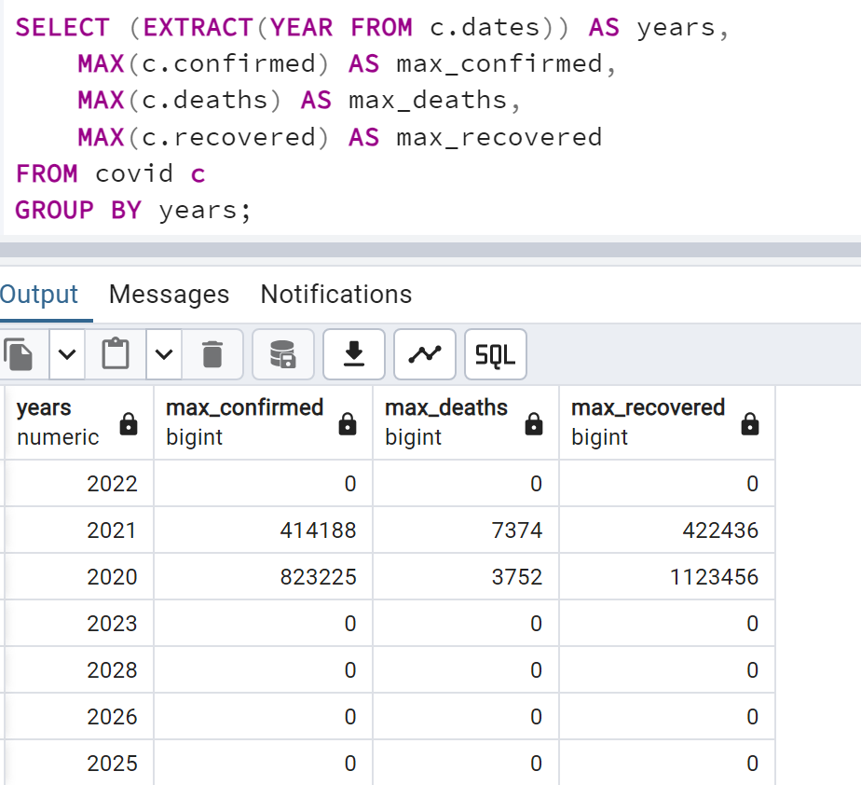
Maximum Count
Q9. Find maximum values of confirmed, deaths, recovered per year

Slide 13
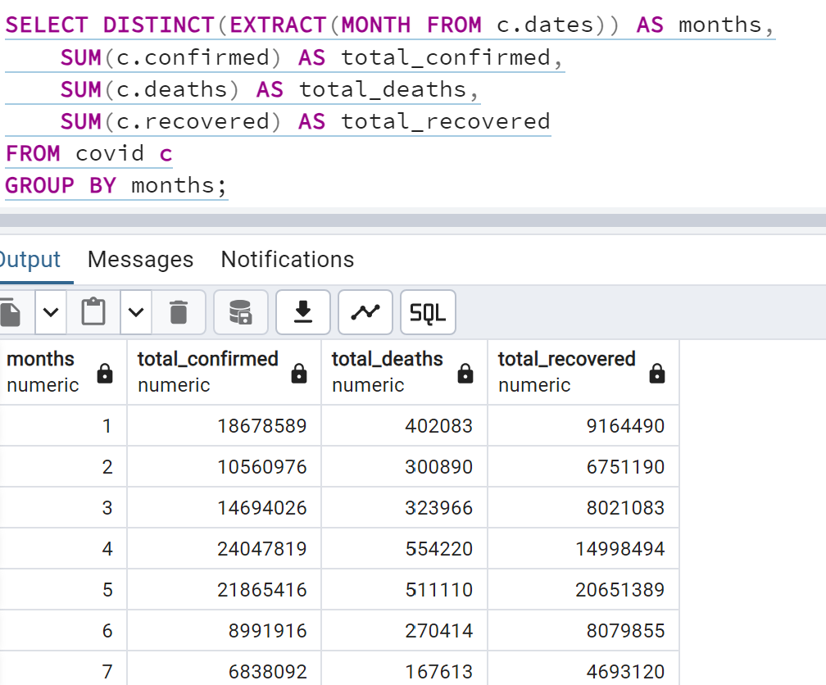
Total Count
Q10. The total number of case of confirmed, deaths, recovered each month

Slide 14
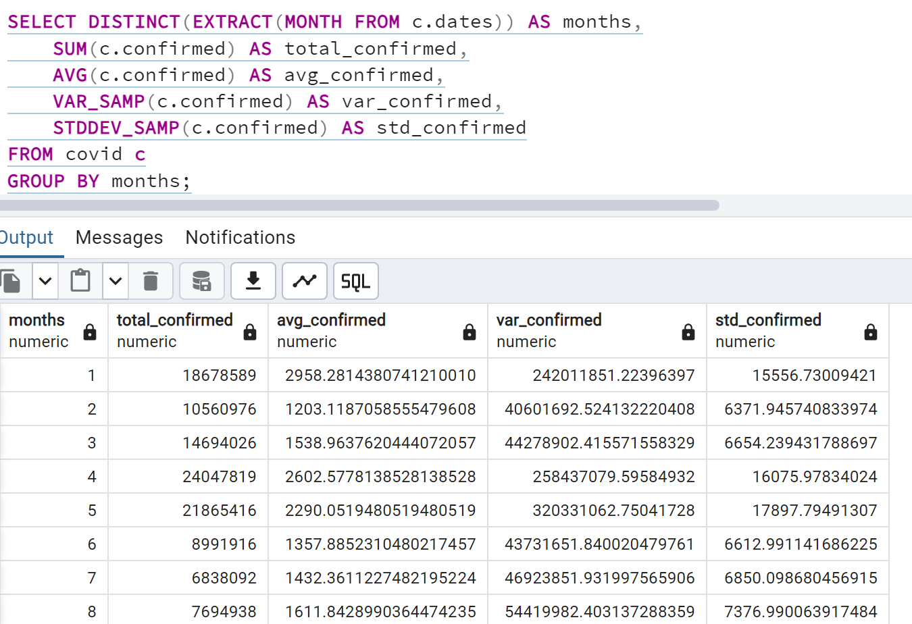
Statistical Confirmed
Q11. Check how corona virus spread out with respect to confirmed case (Eg.: total confirmed cases, their average, variance & STDEV )

Slide 15
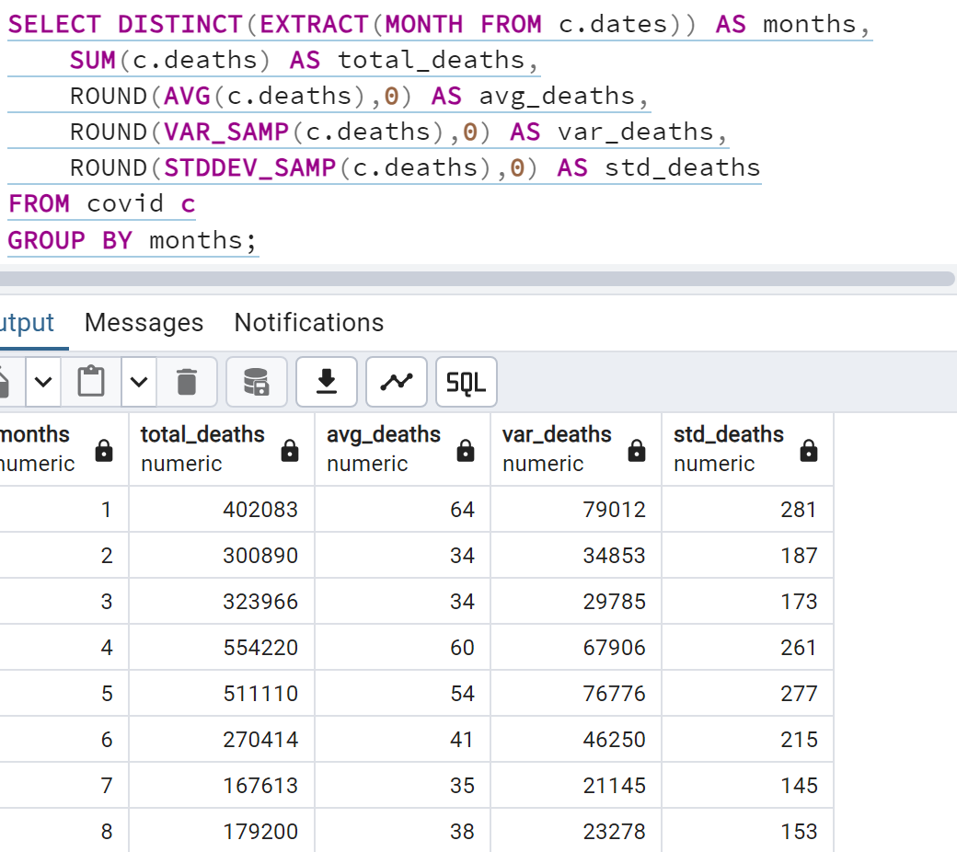
Statistical Deaths
Q12. Check how corona virus spread out with respect to death case per month
(Eg.: total confirmed cases, their average, variance & STDEV )

Slide 16
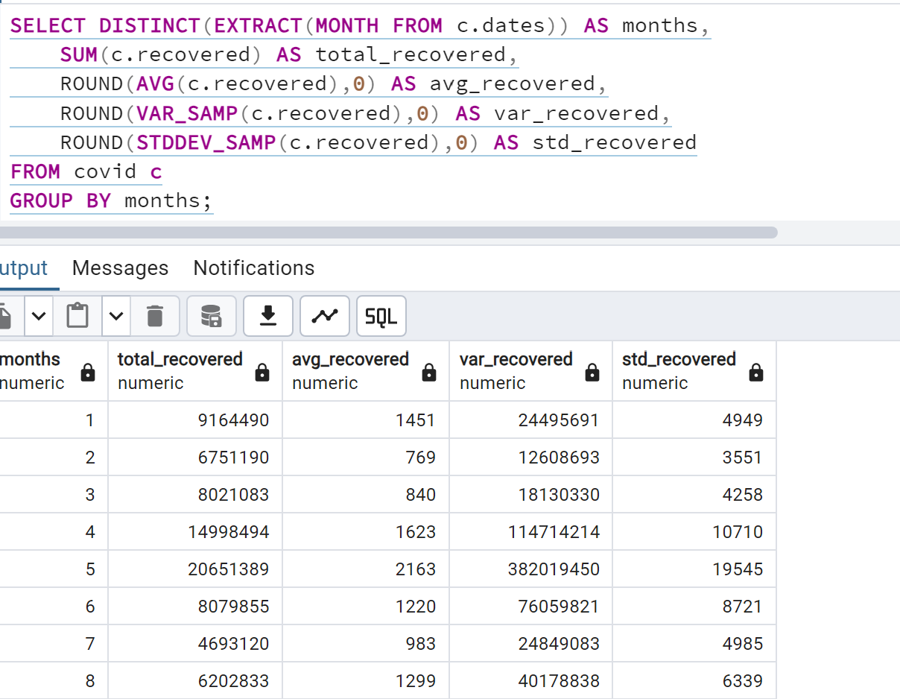
Statistical Recovered
Q13. Check how corona virus spread out with respect to recovered case
(Eg.: total confirmed cases, their average, variance & STDEV )

Slide 17
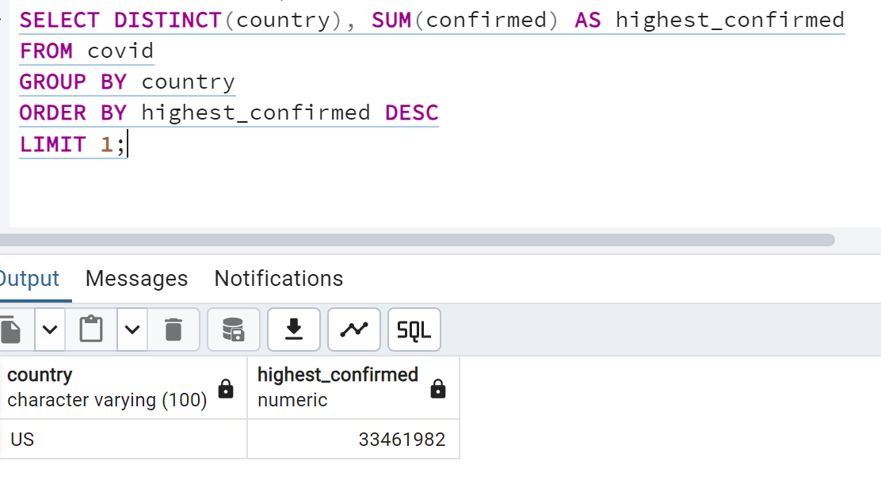
Highest Confirmed
Q14. Find Country having highest number of the Confirmed case

Slide 18
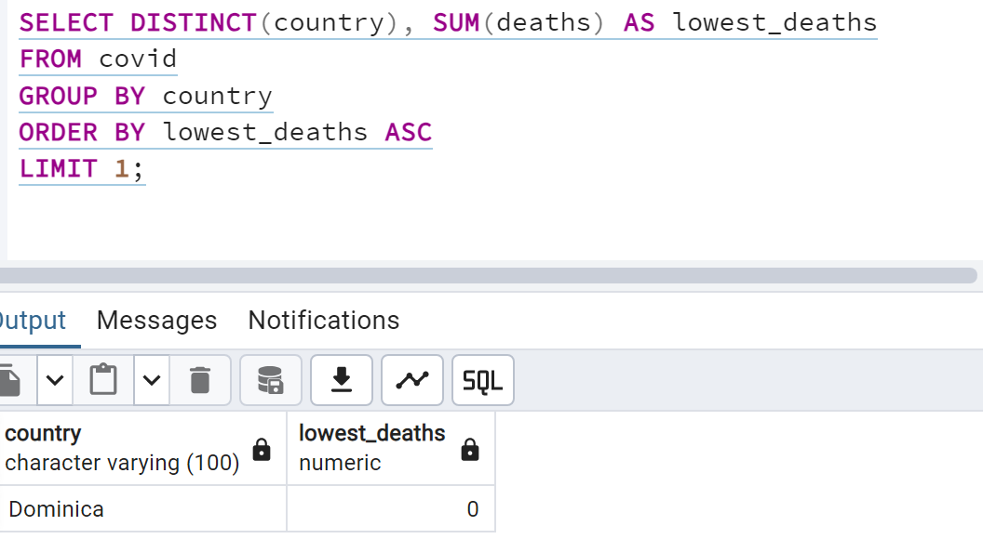
Lowest Deaths
Q15. Find Country having lowest number of the death case

Slide 19
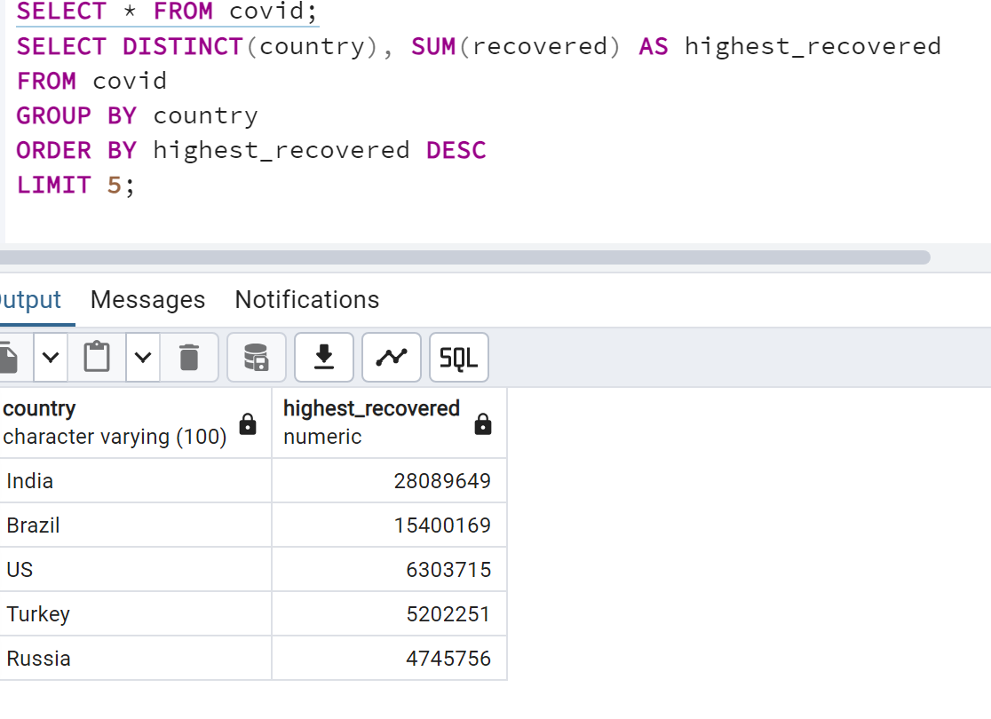
Top 5 Highest Recovered
Q16. Find top 5 countries having highest recovered case

Slide 20
Conclusion
• The dataset, named Coronavirus Dataset, was thoroughly examined for missing or null values. In the event of their
presence, an UPDATE statement along with the IS NULL condition would be used to replace these null values with
zeros. However, no such values were found in the dataset.
• The dataset consists of a total of 78,386 rows, spanning from 22nd January 2020 to 22nd January 2029. A new column, Month Name, was added to facilitate further analysis.
• Upon analyzing the average confirmed cases, it was observed that January, April, May and October had the highest averages. Conversely, February and June had the lowest averages.
• When examining the average death cases, January, April, May and October were the months with the highest averages, while February and June had the lowest averages.
• In terms of average recovered cases, January, April, May were the highest, whereas February, March, and July were the lowest.

Slide 21
Conclusion
• 2020 – 2021 had the maximum confirmed, death and recovered value.
• Total confirmed, death and recovered value were highest in April – May and lowest in July.
• Interestingly, Average, Variance, Standard Deviation of Confirmed case were highest in the month of May and Lowest in February.
• Average, Variance, Standard Deviation of Death case were highest in the month of January and Lowest in February, March.
• Average, Variance, Standard Deviation of Recovered case were highest in the month of May and Lowest in February.
• US had the highest confirmed cases.
• The countries with the highest recovery cases were India, Brazil, USA, Turkey, and Russia.
• This concludes the analysis of the Coronavirus Dataset. The findings provide valuable insights into the spread and impact of the virus across different months and countries.

Slide 22
Thank You
A Presentation by -
Mosharrat Marufa Sigma

